Slide 1

NBA Analysis
Kendall Sisk, Kim Kockenmeister, Raj Ramachandran, Jaimie Koshy

Slide 2
Table of Contents
Theme (storyboard)
Goal/Purpose
The Data
ETL Process
How you did that, screenshots
SQL
Query the data, screenshots
Flask
Routes, api, html screenshots
Visualization
D3, charts, interactive, 3 of them
**Still need to figure out js library- J query (if not, chart librarybasketball
Summary at the end

Slide 3

The data

Slide 4
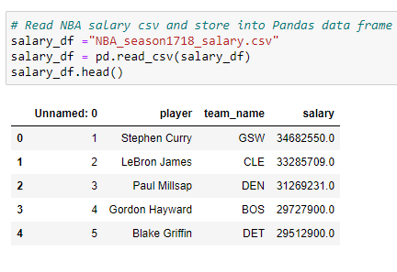
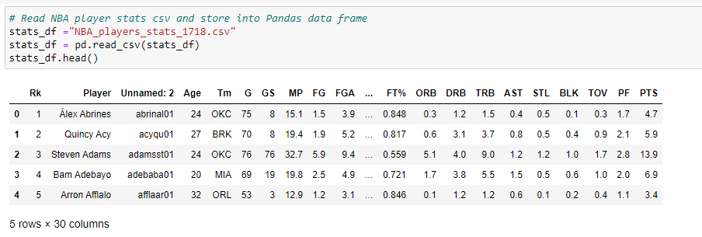
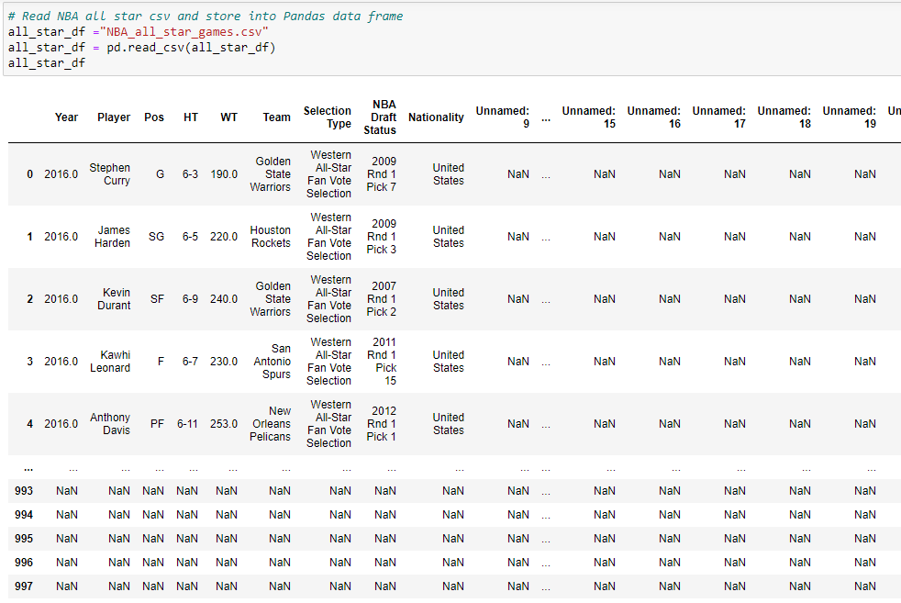
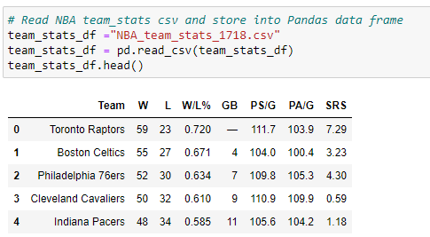
Our Data Consists of 4 Datasets - Extracting
stats_df
salary_df
team_stats_df
all_star_df
Notes:
Our four datasets consist of data on player salary, player stats, team stats, and data on all star game picks. We focused specifically on the 2017-18 season so our datasets were specific to that year.

Slide 5
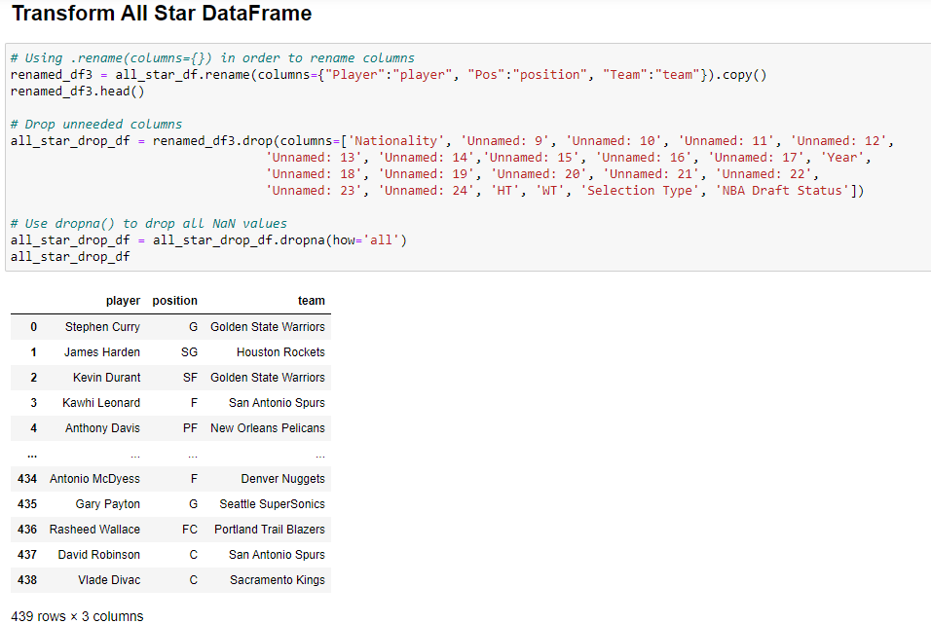
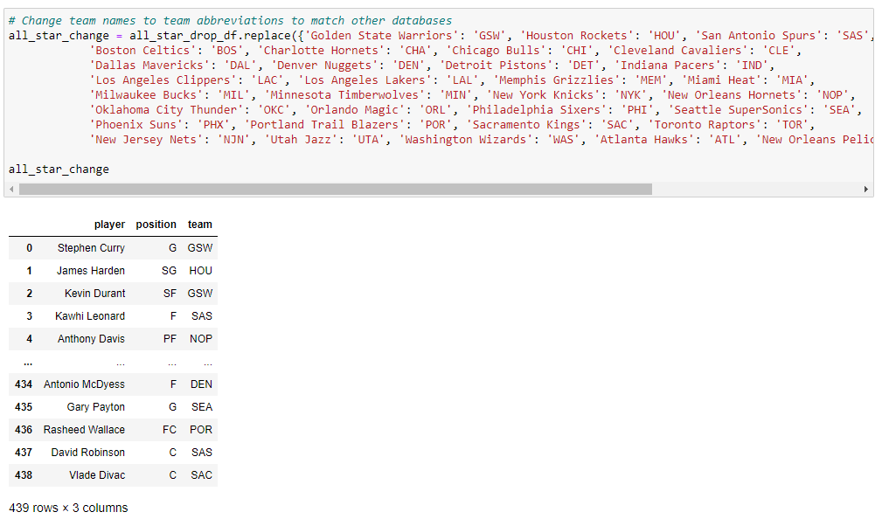
Transforming the Data
1.
2.

Slide 6
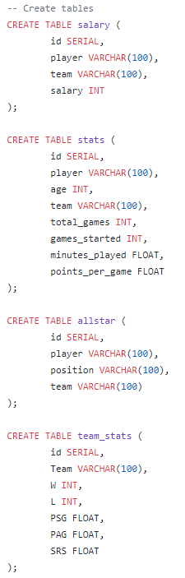
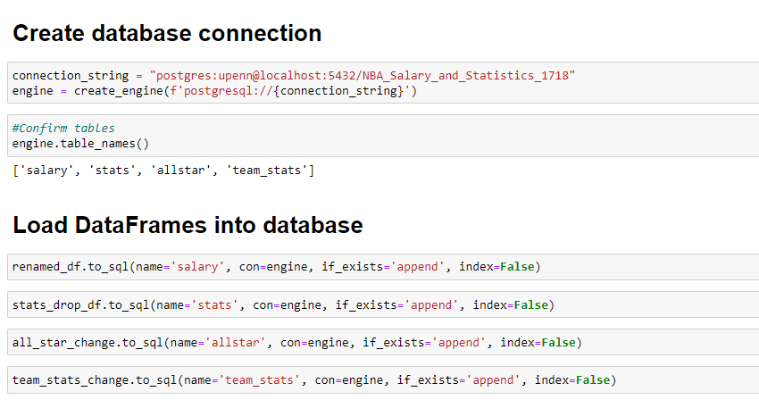
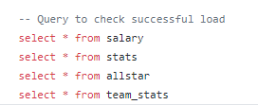
Loading Data into PostgreSQL

Slide 7

Querying the data

Slide 8
[insert screenshots]

Slide 9

Creating the flask

Slide 10
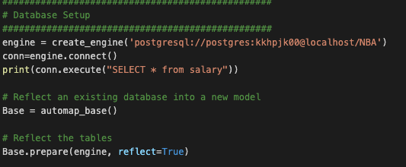
Step 1: Set up database connection to postgres

Slide 11
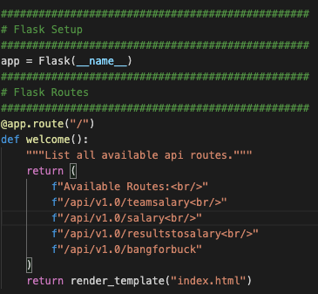
Step 2: Flask set up and flask routes

Slide 12
Step 2a: for each route
Made the connection
Queried the data
Put it in a dictionary and then appended it to a list and then jsonified that list

Slide 13
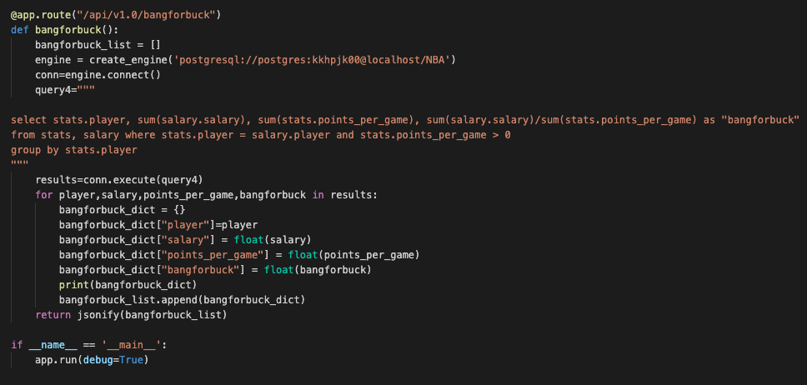
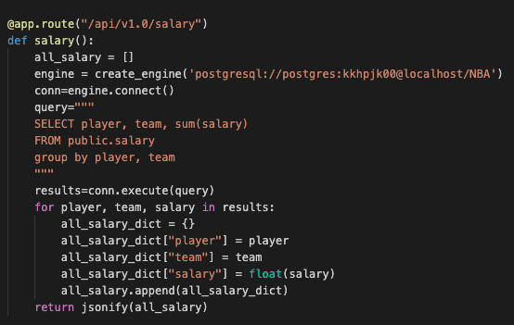
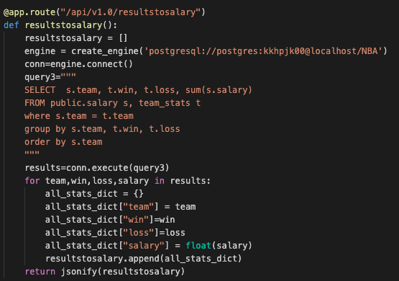
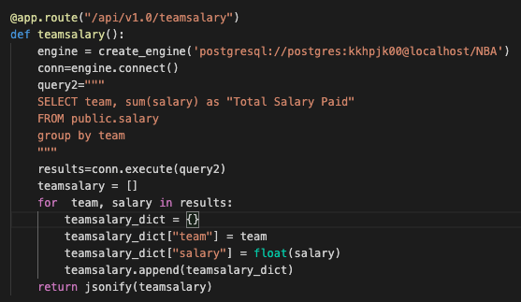
The code

Slide 14
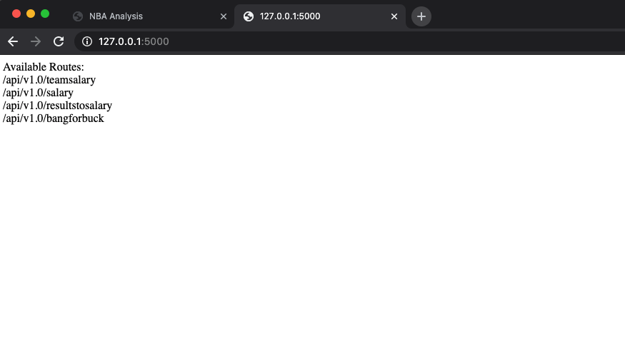
flask End result

